Slide 1
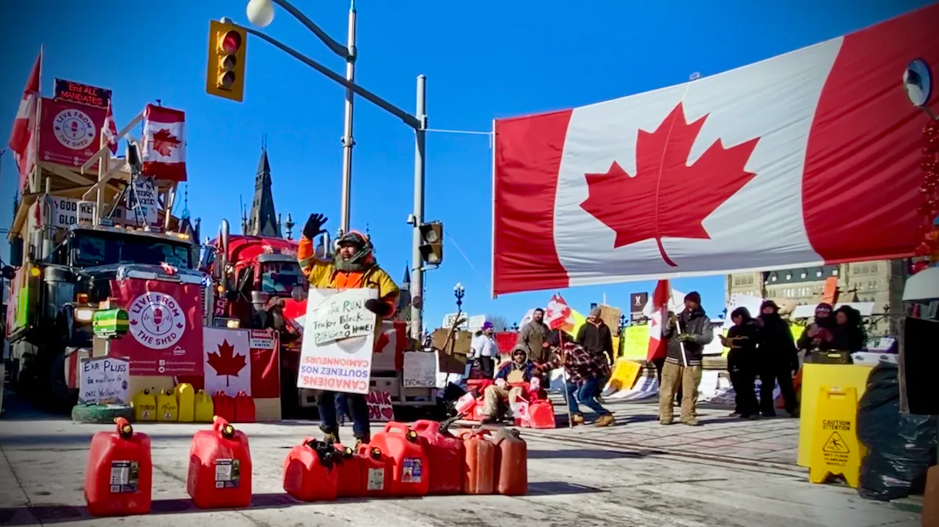
Canadian Charter of Rights and Freedoms

Slide 2
What if at the end of the year, we had a
BUT
I only let the female students in the class vote on what kind of pizza we order?
OR
I only let students with brown eyes vote?
Would that be fair?
I’m the teacher, shouldn’t I be allowed to do this?
Notes:
The basic idea of this provocation is to bring down the idea of a charter to a level that all students can understand. It ensures that those in power don’t abuse their power.

Slide 3
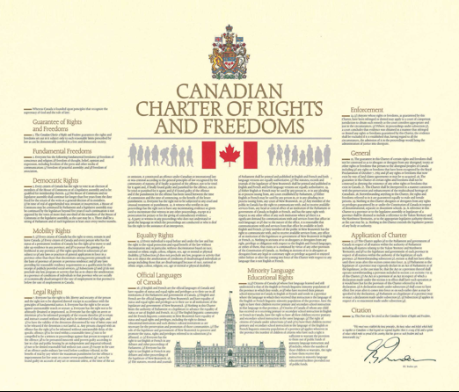

Slide 4
Protected Rights and Freedoms Under the Charter
Fundamental Freedoms
Freedom to express your opinions.
Freedom to choose your own religion.
Freedom to organize peaceful meetings and demonstrations.
Freedom to associate with a person or group.
Democratic Rights
The right to vote for members of the House of Commons and of provincial legislatures.
The right to vote for a new government every five years.

Slide 5
Mobility Rights:
The right to move anywhere within Canada and to earn a living there.
The right to enter, stay in, or leave Canada.
Legal Rights
The right to be free of imprisonment for no reason.
The right to an impartial and quick trial.
Equality Rights
The right to be free of discrimination because of race, national or ethnic origin, religion, gender, age, or mental or physical disability.

Slide 6
How The Charter Is Meant To Work The Charter Regulates How The Government Acts In Order to Protect The Rights and Freedoms of Individuals Inside Canada*.
Government Policies, Actions, and Laws

Slide 7
How The Charter Is Supposed To Work The Charter Regulates How The Government Acts In Order to Protect The Rights and Freedoms of Individuals Inside Canada*.
Government Policies, Actions, and Laws
You and I, as individuals inside Canada*
Notes:
*Certain guaranteed mobility and democratic rights and freedoms only apply to Canadian Citizens (e.g. right to vote and the right to leave and enter Canada freely). The other rights and freedoms are guaranteed to everyone inside Canada, regardless of citizenship.

Slide 8
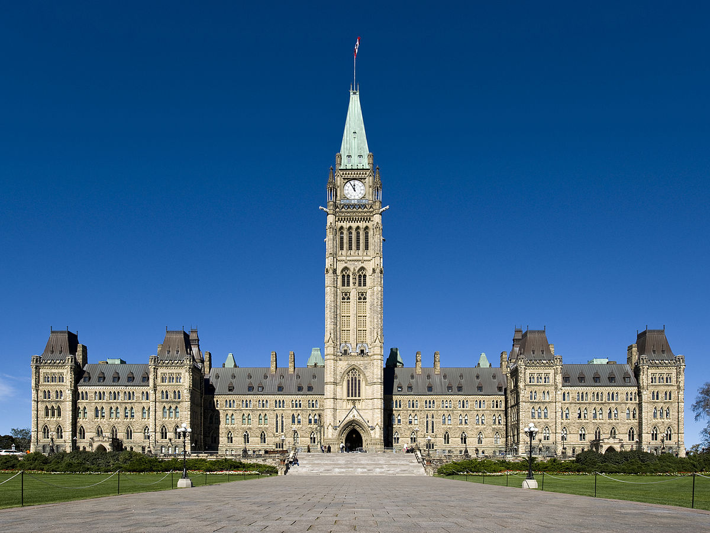
The Charter regulates government behaviour!
The Charter is meant to stop the government from acting in ways that violate the rights and freedoms of individuals.
The Charter does not regulate ordinary people-to-people interactions, just the government’s actions towards people.

Slide 9
Why should I care about the Charter?
Pre-Charter Human Rights Violations in Canadian History
Canada’s historical relationship with First Nations
Residential Schools --------> Intergenerational Trauma
Banning spiritual ceremonies
Preventing First Nations from taking political action
Preventing First Nations people from leaving the reserve
Women being denied the right to vote
Japanese, Ukrainian, and Italian Internment

Slide 10
Why should I care about the Charter?
Charter violations happening today?

Slide 11
It’s Arguably a Charter Violation
Mobility rights
(2) Every citizen of Canada and every person who has the status of a permanent resident of Canada has the right to
(a) …take up residence in any province; and
(b) pursue the gaining of a livelihood in any province.

Slide 12
Why should I care about the Charter?
Hamed told the court, however, that he didn't think he had made an illegal lane change and the officer wasn't telling him why he was being placed under arrest.
Hamed testified that when he asked why Boldirev was treating him like that and why he had assaulted him, Boldirev responded "You think that's an assault? This is not an assault."
Boldirev then punched him twice in the face, leaving him dazed, Hamed said.

Slide 13
It’s Arguably a Charter Violation
Unlawful Search and Seizure
(8) Everyone has the right to be secure against unreasonable search or seizure.

Slide 14
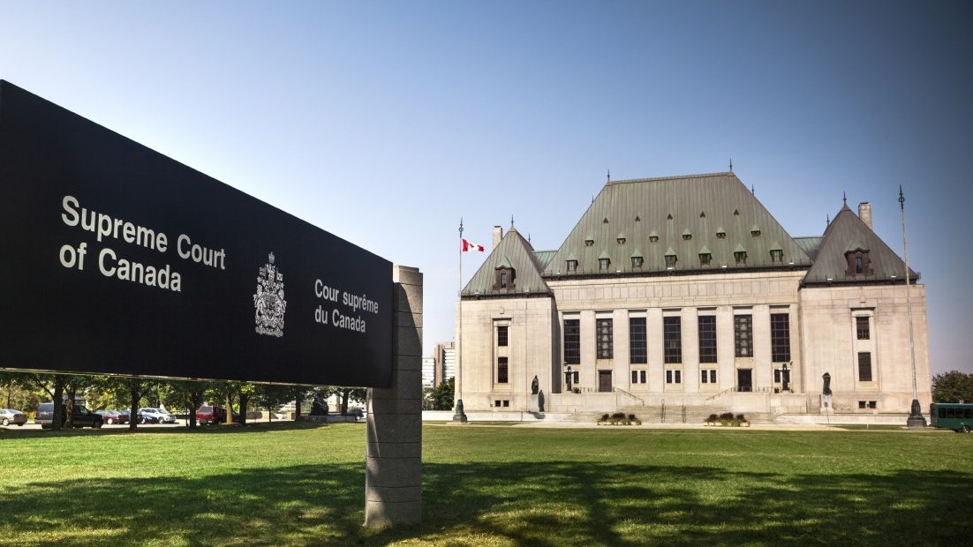
What can I do if I believe my Charter rights and freedoms have been violated?
The judicial (court) system is responsible for hearing charter challenges. They will determine whether or not a violation has occurred.

