Slide 1
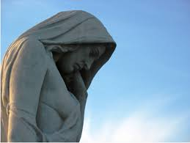
Canada & World War I

Slide 2
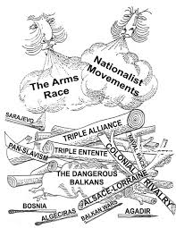
BACKGROUND CAUSES:
NATIONALISM
IMPERIALISM
MILITARISM
ALLIANCE SYSTEMS
BALKANS

Slide 3
1. NATIONALISM
2 TYPES:
1. love / pride / attachment to one’s country
Britain Germany
- Old Empire - Young / aggressive
- NAVY - ARMY
= TENSIONS
2. another type of nationalism growing in colonized countries:
= intense loyalty toward and desire to preserve one's cultural identity, language, traditions Eg. Slavic nations

Slide 4
2. IMPERIALISM
Acquisition of overseas territories
One country controls other countries or regions
→ est. colonies, exploit resources
- #1 empire = Britain
"The Sun never sets on the British Empire“
G wanted big empire - wants its "place in the sun“
Africa is last frontier for colonizers in late 1800s
→ competition for MOROCCO
→ Brit, Fr, & Ger. almost went to war

Slide 6
1. IMPERIALISM cont.
Germany wanted big empire - wants its "place in the sun“
Africa is last frontier for colonizers in late 1800s
→ competition for MOROCCO
→ Brit, Fr, & Ger. almost went to war

Slide 7
Imperialism cont.

Slide 8
3. MILITARISM
Build up of armaments/ weapons - enlisting, training, equipping armed forces ready for war
war seen as acceptable way to resolve conflicts & achieve goals
seen as necessary in order to protect colonies;
source of nat'l prestige
Eg. NAVAL RACE:
British built the "Dreadnought"
Germans built the "Westfalen"
- now G has not only #1 army, it has large navy too!
France nervous - begins to arm itself - wants to maintain balance of power
- arms race = TENSIONS

Slide 9
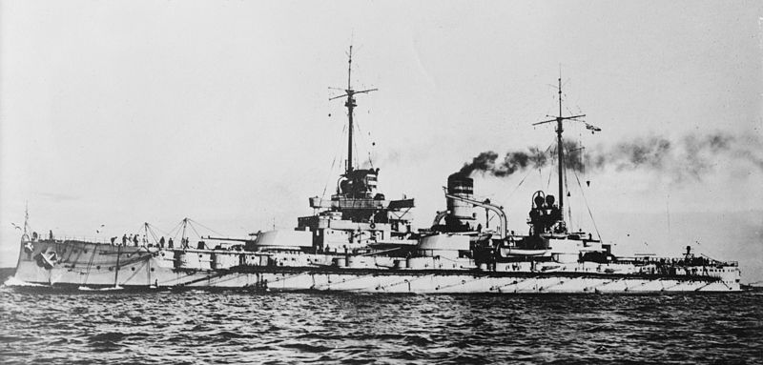
Militarism cont.

Slide 10
4. ALLIANCE SYSTEMS
to reduce threat of war (had the opposite effect)
Triple Alliance Triple Entente
Germany, France
Austria-Hungary Britain
Russia
Italy ------------------------------------→1915
Alliances made countries feel powerful + aggressive

Slide 11
Alliance Systems cont.

Slide 12
Alliance Systems cont.
Notes:
More than 25 countries eventually participated, aligned with either the Allied or the Central powers

Slide 13
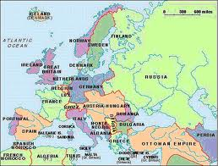
5. BALKANS
Located > Southeast Europe
Russia, A-H, Ottoman Empire all want control
Serbia / Austria-Hungary, Slovenia, Croatia, (Bosnia), Romania, Greece

Slide 14
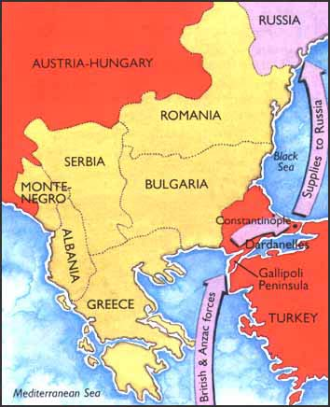
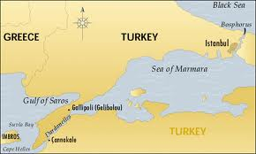
Balkans cont.
Major countries like Russia, Germany + AH had interests in the Balkans
Russia → desire for Pan-Slavism, protect warm water port

Slide 15
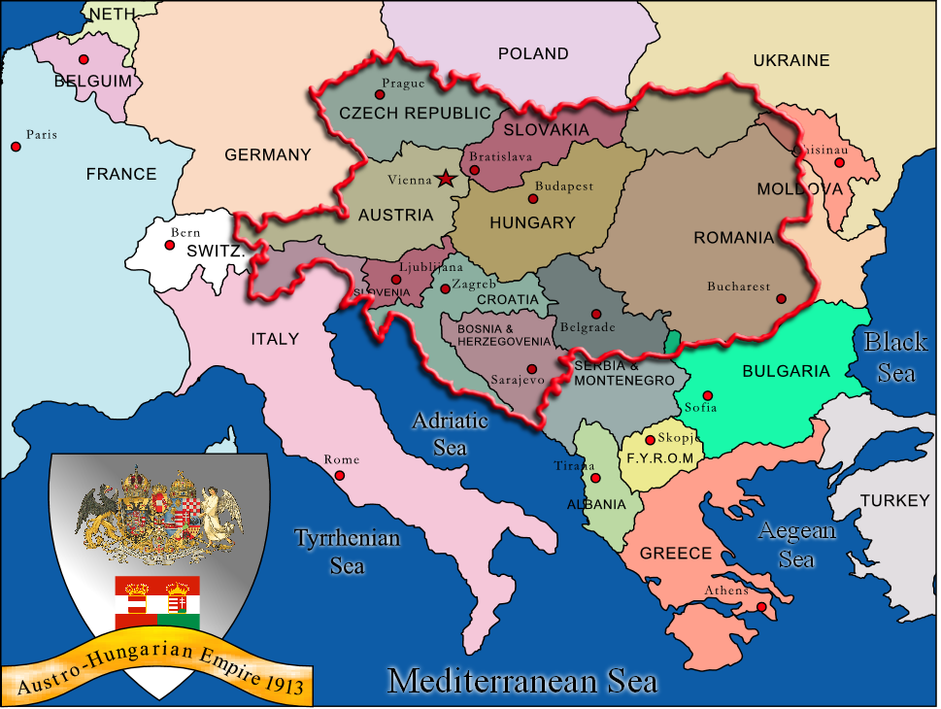
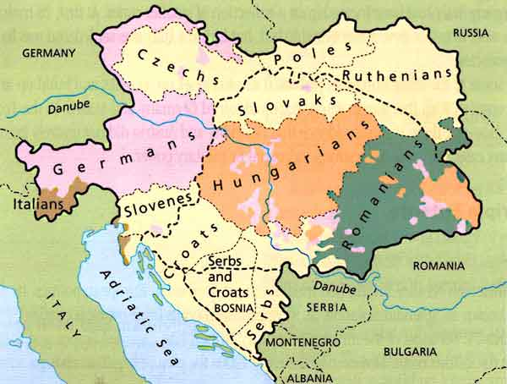
Balkans cont.
A-H → feared Pan-Slavism (many parts of empire
were slavic) A-H feared losing grip of empire

Slide 16
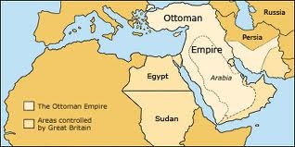
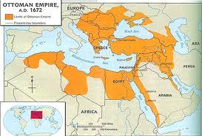
Balkans cont.
Ottoman Empire →controlled area for 100 years, crumbling empire

Slide 17
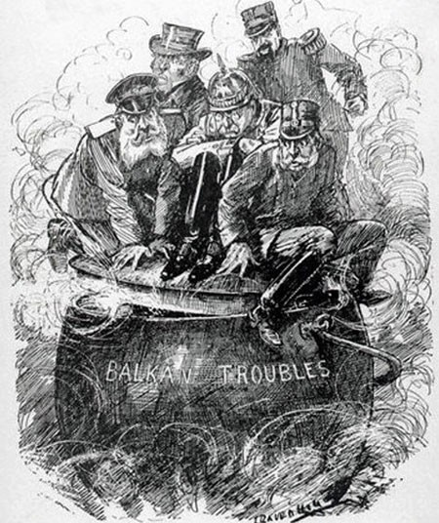
Balkans cont.
= TENSIONS !

Slide 18
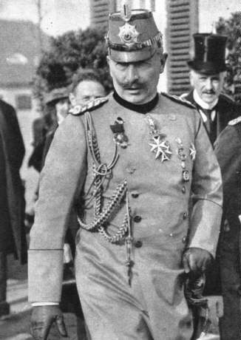

Slide 19
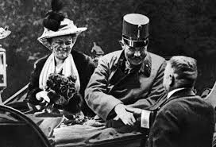
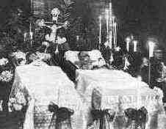
IMMEDIATE CAUSE / Catalyst:
1. Assassination of AH archduke Franz Ferdinand

Slide 20
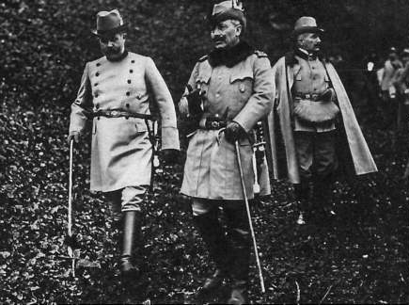
WILHELM AND FERDINAND

Slide 21
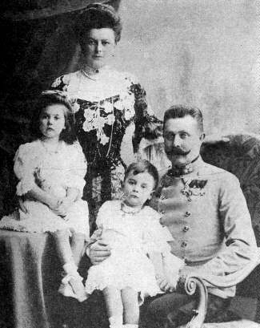
FRANZ FERDINAND + FAMILY

Slide 22
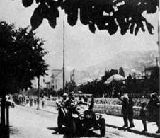
CAVALCADE

Slide 23
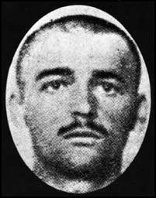
CABRINOVIK HURLS BOMB
Cabrinovik throws bomb; takes poison, jumps off into river. Lives… arrested.
Notes:
June 28 was also Franz Ferdinand’s wedding anniversary. His beloved wife, Sophie, a former lady-in-waiting, was denied royal status in Austria due to her birth as a poor Czech aristocrat, as were the couple’s children. In Bosnia, however, due to its limbo status as an annexed territory, Sophie could appear beside him at official proceedings. On June 28, 1914, then, Franz Ferdinand and Sophie were touring Sarajevo in an open car, with surprisingly little security, when Serbian nationalist Nedjelko Cabrinovic threw a bomb at their car; it rolled off the back of the vehicle and wounded an officer and some bystanders. Later that day, on the way to visit the injured officer, the archduke’s procession took a wrong turn at the junction of Appel quay and Franzjosefstrasse, where one of Cabrinovic’s cohorts, 19-year-old Gavrilo Princip, happened to be loitering.
Seeing his opportunity, Princip fired into the car, shooting Franz Ferdinand and Sophie at point-blank range. Princip then turned the gun on himself, but was prevented from shooting it by a bystander who threw himself upon the young assassin. A mob of angry onlookers attacked Princip, who fought back and was subsequently wrestled away by the police. Meanwhile, Franz Ferdinand and Sophie lay fatally wounded in their limousine as it rushed to seek help; they both died within the hour.

Slide 24
CITY HALL

Slide 25
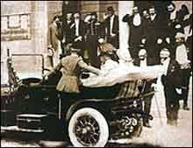

Slide 26
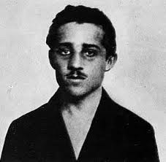
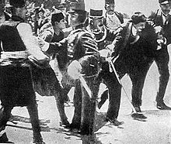
Immediate Cause Catalyst cont.
Killed by the “Black Hand”
→ Gavrillo Princip;
(Bosnian Serb)
Want “self-determination”
→ right to govern themselves

Slide 27
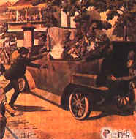
Princip killed Ferdinand and Sophie and then tried to kill himself…

Slide 28
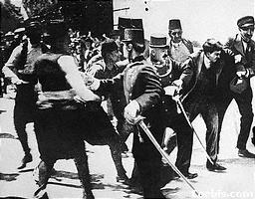
PRINCIP ARRESTED

Slide 29
Arrested, questioned, eventually gives up the other conspirators who had escaped to Serbia...

Slide 30
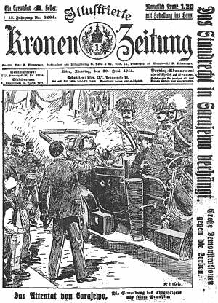

Slide 31
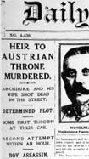

Slide 33
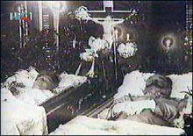

Slide 34
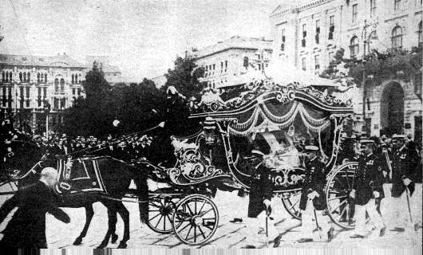
FERDINAND’S FUNERAL

Slide 35
Immediate Cause Catalyst cont.
2. Austria blames Serbia for assassination
3. Germany gives A-H “blank cheque” support if A-H attacks Serbia
4. Austria declares war on Serbia

Slide 36
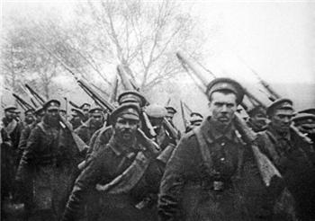
Immediate Cause Catalyst cont.
5. Russia mobilizes to defend Serbia
6. Germany declares war on Russia
7. France declares war on Germany
8. Germany declares war on France

Slide 37
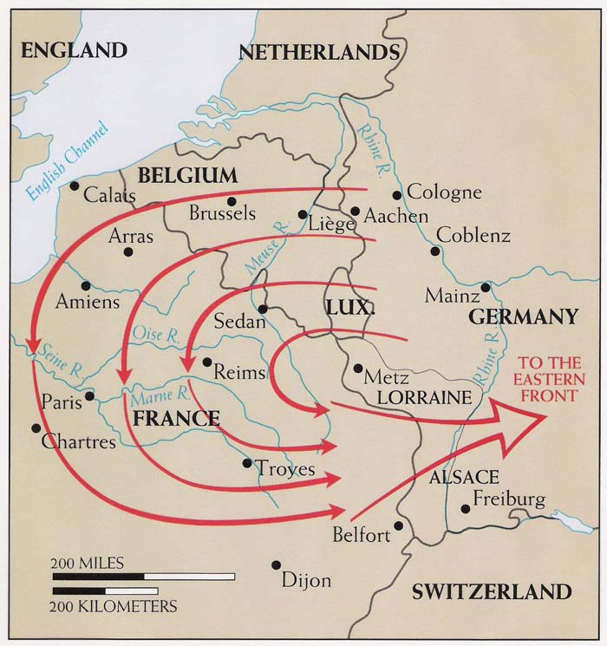
Immediate Cause Catalyst cont.
9. Germany attacks France through neutral Belgium (Schlieffen Plan) – they hoped to achieve a
“One-Front War”
(counted on it taking
Russia a longer time
to mobilize)

Slide 38
Immediate Cause Catalyst cont.
10. Because neutral Belgium was invaded, Britain joins the war
11. Canada automatically joins w/ Britain b/c part of Empire

Slide 39
To Review:
http://www.history.com/this-day-in-history/archduke-franz-ferdinand-assassinated

Slide 40
Canada & WWI (1914-1918)
Joining the war:
automatic entry → part of British Empire
1914 many volunteers /30,000 in 1st month (opposite of conscription)
- women, Aboriginals, African & Japanese Canadians were discriminated against

Slide 41
2. Why did we join:
Believed to be a short war and saw chance to be heroes - very patriotic
the poor had no choice, needed income
protect mother country (Britain)
many more English joined than French Canadian
- by 1917 → few volunteers
→ leads to conscription (crisis)

Slide 42
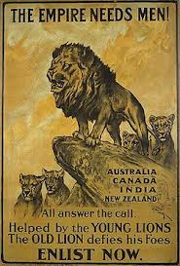
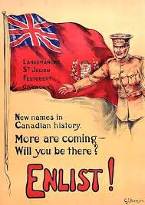

Slide 43
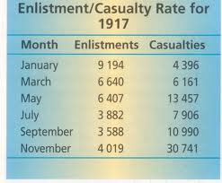

Slide 44
3. Training the Troops:
- training @ Valcartier, Quebec
b/f war, Cdn. was patchwork of regions - little contact.
- Bootcamp/training dev’d sense of National Identity/being Cdn.

Slide 45
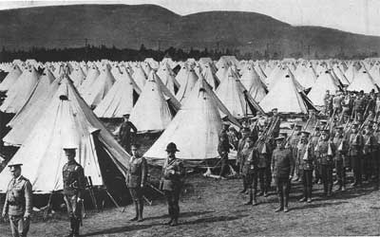
Training the troops cont.
army formed fr. these volunteers was known as the (CEF) Canadian Expeditionary Force
→fought as separate Cdn unit.
- 32,000 ill-prepared Cdn and Nflnd troops set sail for England in 32 transport ships

Slide 46
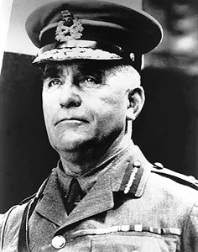
4. Sam Huges – Canada’s Minister of Militia:
- in charge of the armament industry, created the “Shell Committee”

Slide 47
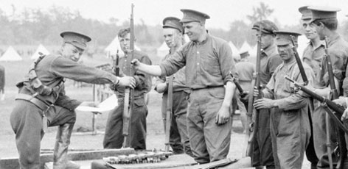
Sam Hughes cont.
A. * ROSS RIFLE
→ many problems / not good like Lee- Enfields that British used
→ too long for trenches / jammed/ misfired
Notes:
The Ross Rifle Scandal
http://www.canadahistory.ca/vimy/Background/weapons/rossrifle.htm
During the South African War of 1899-1902, the Canadian government had experienced serious problems in obtaining weapons from Britain, on whom it relied for its supplies. In particular the .303 Lee-Enfield rifle was unavailable, and efforts to persuade Birmingham Small Arms Company to set up a branch factory in Canada to manufacture the rifle were unsuccessful. Sir Wilfred Laurier, then the Prime Minister, was persuaded by his Militia Minister, Sir Frederick Borden, that Canada would have to make its own rifle. A new rifle, developed by Sir Charles Ross, had recently appeared on the market. It was a fine target and sporting weapon. Ross came to Ottawa and met with a committee set up to evaluate his rifle. One of the committee members was Sam Hughes, who immediately liked the weapon. It was put through a series of tests, including comparison tests with the Lee-Enfield. In spite of the fact that the Ross jammed and often misfired, the committee recommended its adoption and manufacture in Canada. What "small problems" there were, Sir Charles Ross assured them, could be eliminated with the appropriate modifications. Sam Hughes steadfastly defended the Ross rifle in the House of Commons and was opposed to replacing it. Events were to show that he was tragically wrong. In trench conditions, surrounded by mud and filth, and when it was essential to have a reliable weapon, the Ross was definitely out of place. It had a long barrel and was difficult to use in the trench's confined spaces, and it frequently jammed. It was indeed a fine weapon - on a firing range under controlled conditions. But the First Division's stand at Ypres in the face of a gas attack, Canadian soldiers threw away their Ross rifles in despair and frustration, and picked up Lee-Enfields from dead British soldiers on the battlefield. In spite of this, the Second Division went to France with Ross rifles and again the results were much the same, with solders throwing away jammed weapons. By July 1916 Sir Douglas Haig, the new Commander-in-Chief, had ordered the replacement of all Ross rifles by the Lee-Enfield, then becoming widely available. To the end, Hughes refused to accept that there were problems with the Ross, and it took the intervention of many influential people to persuade him otherwise. In November 1916, Hughes resigned, after the new Prime Minister's (Sir Robert Borden, who incidentally was the cousin of Sir Frederick Borden) decision to appoint a Minister of Overseas Forces. Hughes died in 1921 at the age of 69.

Slide 48
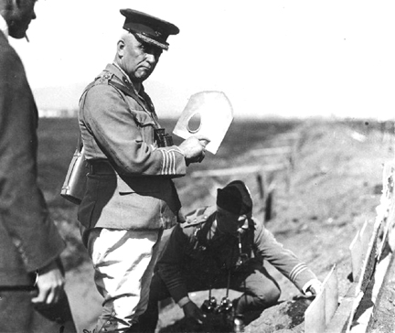
(Also, the McAdam Shield Shovel)
Notes:
The McAdam Shield Shovel
Bruce Ricketts
My father once told me that the features of a good shovel were stiffness and lifting area. If the shovel was not stiff enough it would wobble and bend and if the area was too large it would be too hard to lift. Conversely, if the area was too small, the shovel would require more work. I wonder what he would have said about the McAdam Shield Shovel.The McAdam Shield Shovel was designed to solve two issues on the battlefields of WWI. Conceived by Ena McAdam, personal secretary to Sam Hughes, the Canadian minister for the Department of Militia and Defence in 1913, the shovel held the combined function to operate as a spade and a shield from which soldiers could securely fire from at enemy positions and advantageously not be targeted in return. The shovel was broad and flat - with a hole in it!
But there were two problems with the shovel. As a shield it had to protect the sniper from return fire, so it was quite thick - and heavy. Even with all the thickness it was not able to deflect a bullet from almost any German gun. Secondly, as a shovel it was flat with a hole in it. That made it difficult to use at the best of time.
In 1914, Hughes ordered 25,000 of the shovels at a cost of $34,000. After field testing, most of the theatre commanders refused to issue the shovels to their troops. The project was cancelled and the shovel sold for scrap for $1,400. However not all the shovels were scrapped. Apparently some Canadian snipers employed the units by sticking multiple shovels together to create a thicker shield.
It is not known if any of the McAdam Shield Shovels still exist today.

Slide 49
Sam Hughes cont.
B. CORRUPT → Hughes was poor administrator
– Ministry bogged down with patronage, inefficiency, confusion, and profiteers – gave friends contracts.
- Hughes dismissed in 1916 but still knighted by King George!

Slide 50
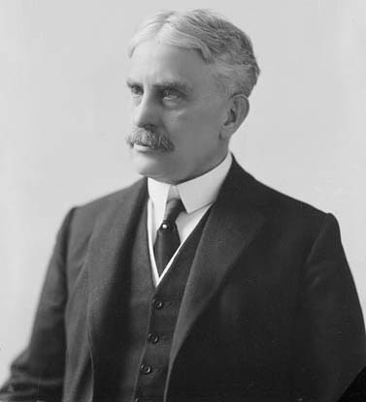
5. War Measures Act:
- 1914 / martial law
- introduced by PM Borden
a) gov’t restrict civil rights
b) gov’t could intervene in economy, control transportation, manufacturing, agriculture.
c) could arrest & detain for 90 days w/ no charge, family not notified

Slide 51
War Measures Act cont.
d) CENSORSHIP of the mail from frontlines

Slide 52
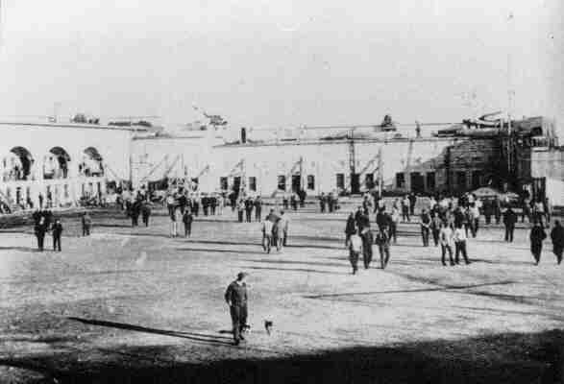
War Measures Act cont.
e) “enemy” immigrants put in jail / est. internment camps (Gov’t run camps where people considered a threat were detained)
→ “Enemy aliens” many from A-H, Ukraine, Germany
→ racism (Berlin, Ontario re-named Kitchener)

Slide 54
Notes:
Internment camp otter creek bc

Slide 55
Notes:
Internees hauling wood

Slide 57
Nature of War
1. Stale tactics “TRENCH WARFARE”
a) defensive
b) 960 km of trenches from Belgian coast to Switzerland
c) ordered to go "over the top" by commanders
d) area between trenches "No Man's Land" filled with corpses, barbed wire, mines, snipers

Slide 60
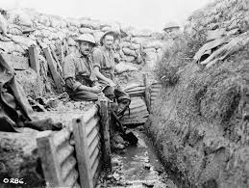

Slide 68
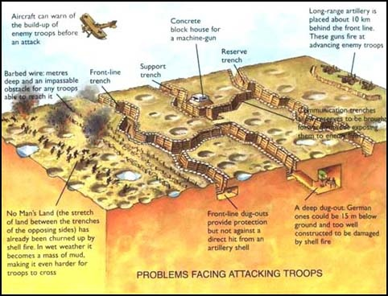

Slide 69
Notes:
No Man's Land
The stretch of land between the front line trenches was dangerous. No Man's Land contained miles of barbed wire, hundreds of corpses, and land mines. Sometimes as narrow as 15 yards or as wide as several hundred yards, No Man's Land was heavily guarded by machine gun and sniper fire. Soldiers were forced to cross No Man's Land to advance or scout for enemy positions. Official truces were often necessary to retrieve the wounded or bury the dead.

Slide 70
Notes:
No man’s land

Slide 73
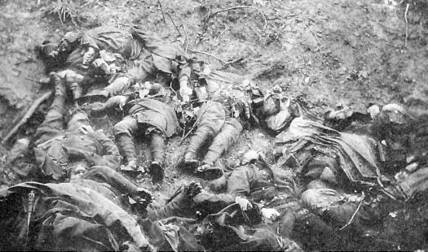
Conditions:
1. stench of corpses

Slide 74
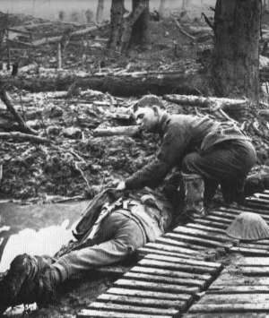
Trench warfare cont.
2.winter → frozen ground
3. spring → quagmire / rain / trench foot
“Duck Boards”

Slide 75
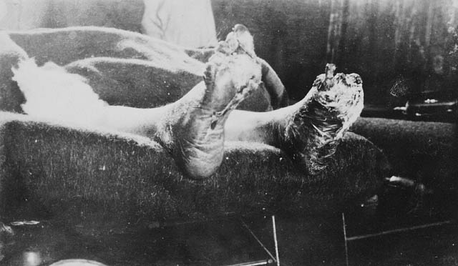
Trench Foot
Notes:
Trench foot is a medical condition caused by prolonged exposure of the feet to damp, unsanitary, and cold conditionsAffected feet may become numb, affected by erythrosis (turning red) or cyanosis (turning blue) as a result of poor vascular supply, and feet may begin to have a decaying odour due to the possibility of the early stages of necrosis setting in. As the condition worsens, feet may also begin to swell. Advanced trench foot often involves blisters and open sores, which lead to fungal infections; this is sometimes called tropical ulcer (jungle rot).

Slide 76
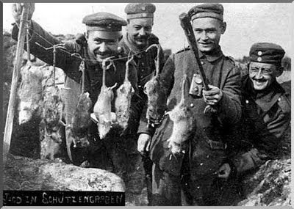
Trench warfare cont.
4. rats, lice, flies, disease
Notes:
German soldiers cooking rats; lice in kilts – soldiers ironed them and hisssss – typhoid in low lands (night soil) – and drowning in latrines in Galipolli

Slide 77
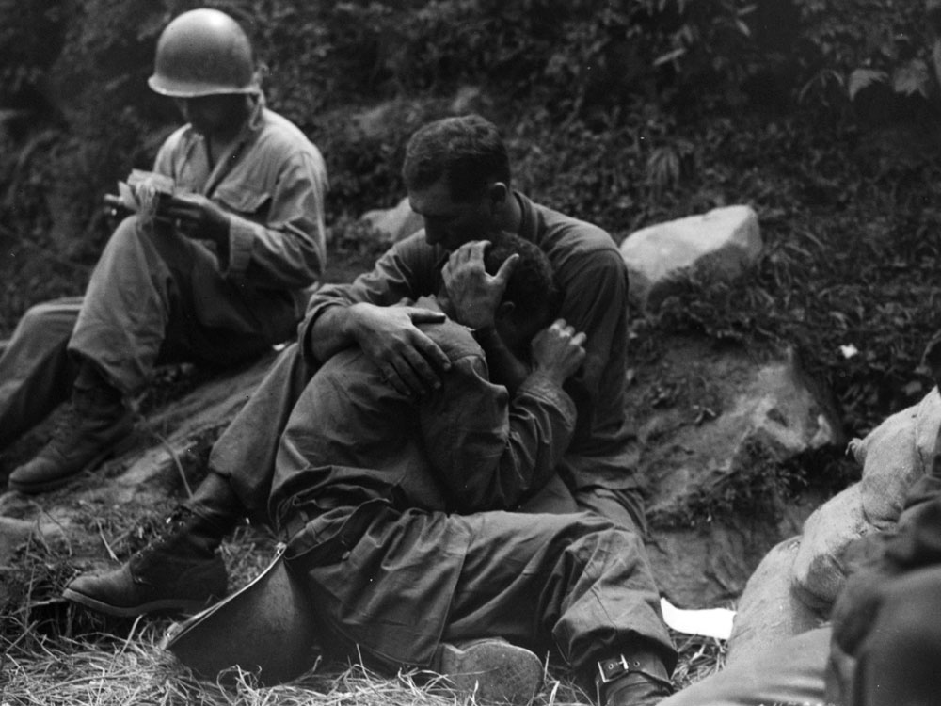
Trench warfare cont.
5. shell shock, nerves

Slide 78
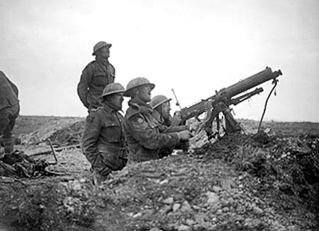
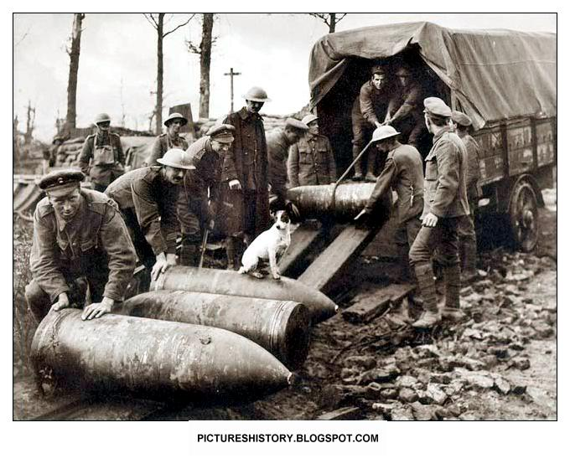
2. Modern Technology
a) artillery/ machine guns (by 1914)

Slide 79
The Frontlines (National Film Board)
https://www.nfb.ca/film/front-lines-the-trenches/

Slide 80
What did it look and sound like?
http://www.youtube.com/watch?v=0-jV0nrezI8

Slide 81
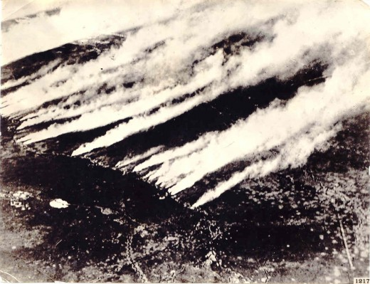
2. Modern Technology
b) poisonous gas (2nd battle of Ypres)

Slide 83
Notes:
See notes on how chlorine and mustard gas works

Slide 87
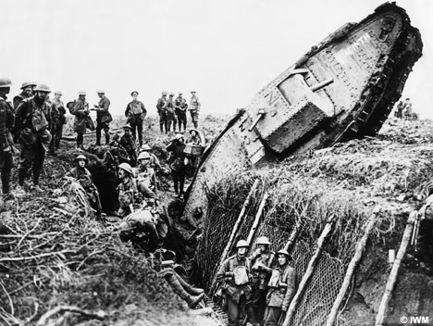
2. Modern Technology
c) tanks – offensive weapon to go through barbed
wire (by 1916)

Slide 88
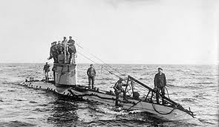
2. Modern Technology
d) u-boats (submarines)

Slide 89
2. Modern Technology
e) airplanes (spy on enemy activity; eventually
carried weapons)

Slide 90
Deadly combination of old tactics and new technology led to:
“WAR OF ATTRITION” → “bleed them white”
attrition: each side repeatedly attacking the other until one was completely exhausted and unable to continue.

Slide 91
Notes:
The military mainly used horses for logistical support during the war; they were better than mechanized vehicles at traveling through deep mud and over rough terrain. Horses were used for reconnaissance and for carrying messengers, as well as pulling artillery, ambulances, and supply wagons. The presence of horses often increased morale among the soldiers at the front, but the animals contributed to disease and poor sanitation in camps, caused by their manure and carcasses. The value of horses, and the increasing difficulty of replacing them, was such that by 1917 some troops were told that the loss of a horse was of greater tactical concern than the loss of a human soldier. Ultimately, the Allied blockade prevented the Central Powers from importing horses to replace those lost, which contributed to Germany's defeat. By the end of the war, even the well-supplied U.S. Army was short of horses.
Conditions were severe for horses at the front; they were killed by artillery fire, suffered from skin disorders, and were injured by poison gas. Hundreds of thousands of horses died, and many more were treated at veterinary hospitals and sent back to the front. Procuring equine food was a major issue, and Germany lost many horses to starvation through lack of fodder. Several memorials have been erected to commemorate the horses that died. Artists, including Alfred Munnings, extensively documented the work of horses in the war, and horses were featured in war poetry. Novels, plays and documentaries have also featured the horses of World War I.

Slide 92
Canadian Battles:
Second Battle of Ypres: (April 1915)
Germans use chlorine gas
> had been outlawed by int’l agreement since 1907
> French & Cdn troops blinded, burned or killed
In following months, neither side gained much advantage.
- 6000 Canadians killed, wounded, or captured during next month.

Slide 93
Canadian Battles – YPRES cont.
Notes:
Ypres, Second Battle of 22 April to 25 May, 1915. At the Second Battle of Ypres the Germans attacked, using chlorine gas for the first time. The French Algerian Division fled but the Canadians repulsed numerous assaults. Four Canadians won the Victoria Cross (painting by Richard Jack, courtesy Canadian War Museum/8179).

Slide 94
Canadian Battles cont.
Battle of the Somme: (July 1916)
- Brit & French commanded by General Haig → used old strategies – useless
- Troops ordered to march across open fields, mowed down by German machine guns.
Notes:
Frank Maheux, a lumberjack from Quebec, described the scene to his wife:
"All my friends have been either killed or wounded ... My dear wife, it is worse than hell here. For miles around, corpses completely cover up the ground. But your Frank didnt get so much as a scratch. I went to battle as if I had to cut wood with my bayonet. When one of my friends was killed at my side, I saw red: some Germans raised their arms in surrender, but it was too late for them. I will remember that all my life."

Slide 95
Canadian Battles – SOMME cont.
700 men (85%) of Royal Newfoundland Regiment killed or wounded in half an hour.
Beaumont Hamel Memorial

Slide 96
Canadian Battles – SOMME cont.
Notes:
Aerial view of Regina and Kenora trenches – The Somme 1916

Slide 97
The Somme Nicknamed “The Blood Bath”
Notes:
Thurston Topham’s Night Scene On The Somme.

Slide 98
Canadian Battles – SOMME cont.
Almost 24,000 Canadians among casualties.
- Battle lasted months; by end of November, over 1 000 000 casualties – almost equal on both sides, Haig claimed victory.

Slide 99
Vimy Ridge: 1917
- Germans controlled the ridge since 1914
- French tried 3 times to gain it, > Canadians succeeded under Brit General Julian Byng
Notes:
Canadian machine gun crews

Slide 100
Notes:
See file on Currie

Slide 101
Canadian Battles – Vimy cont.
- Gained more ground, took more prisoners, captured more artillery than any other previous British offensive the entire war.
- 3500 killed, 7000 wounded, but great success b/c of planning.
Notes:
Vimy Canadian stretcher beares and German prisoners bring in the wounded
Canadians fire a captured gun at retreating Germansty5[ot643r3q
E[

Slide 102
Canadian Battles – Vimy cont.
** Canadian milestone **
→ gain greater sense of National Identity

Slide 103
Vimy Documentary
https://www.youtube.com/watch?v=AlRI94wLH0I
https://www.youtube.com/watch?v=nu4VUh3AW3g

Slide 104
Canadian Battles – Vimy cont.

Slide 105
To the valour of their Countrymen in the Great War And in memory of their sixty Thousand dead this monument Is raised by the people of Canada
- Inscription on monument
http://www.bbc.com/news/world-us-canada-28061542
Notes:
Canada's most impressive tribute overseas to those Canadians who fought and gave their lives in the First World War is the majestic and inspiring Canadian National Vimy Memorial which overlooks the Douai Plain from the highest point of Vimy Ridge, about ten kilometres north of Arras. The Memorial does more than mark the site of the engagement that Canadians were to remember with more pride than any other operation of the First World War. It stands as a tribute to all who served their country in battle in that four-year struggle and particularly to those who gave their lives. At the base of the Memorial, these words appear in French and in English:
To the valour of their Countrymen in the Great War And in memory of their sixty Thousand dead this monument Is raised by the people of Canada
- Inscription on monument
Carved on the walls of the monument are the names of 11,285 Canadian soldiers who were killed in France and whose final resting place was then unknown. Standing on the monument’s wide stone terrace overlooking the broad fields and rolling hills of Northern France, one can see other places where Canadians fought and died. More than 7,000 are buried in 30 war cemeteries within a 20-kilometre radius of the Canadian National Vimy Memorial. Altogether, more than 66,000 Canadian service personnel died in the First World War.
Designed by Canadian sculptor and architect Walter Seymour Allward, the monument took eleven years to build. It rests on a bed of 11,000 tonnes of concrete, reinforced with hundreds of tonnes of steel. The towering pylons and sculptured figures contain almost 6,000 tonnes of limestone brought to the site from an abandoned Roman quarry on the Adriatic Sea (in present day Croatia). The figures were carved where they now stand from huge blocks of this stone. A cloaked figure stands at the front, or east side, of the monument overlooking the Douai Plain. It was carved from a single, 30-tonne block and is the largest piece in the monument. This sorrowing figure of a woman represents Canada—a young nation mourning her dead. Below is a tomb, draped in laurel branches and bearing a helmet and sword.

Slide 108
Passchendaele:
Cdn General Arthur Currie appointed to command troops (1st time)
no real strategic value - Gen. Haig ordered Currie to attack
→ Currie warned casualties would be high, Haig wouldn’t change the order.

Slide 109
Aerial view of Passchendaele village before and after the battle

Slide 110
Canadian Battles Passchendaele cont.
- huge craters from shelling, when rained, turned to bogs – soldiers & horses drowned

Slide 111
Canadian Battles Passchendaele cont.
Allies won the battle, but cost was very high.
- 15 000 Canadian casualties - nearly half a million soldiers from both sides.
Notes:
In his memoirs (1938) Lloyd George wrote, "Passchendaele was indeed one of the greatest disasters of the war ... No soldier of any intelligence now defends this senseless campaign ...".

Slide 112
Canadians fought in France & Belgium

Slide 113
War in the Air
- start of war, Canada did not have airforce
→ enlist in RFC “royal flying corps” (av. 3 weeks survival as a pilot)
- aircraft used for:
1) reconnaissance
2) bomber & fighter aircraft
→ “dog fights”
→ “ace” (shoot down 5)
ie. Billy Bishop
-Roy Brown shot “Red Baron”
Notes:
On the morning of 21 April, No. 209 was on patrol when they became engaged in combat with fighters of Jagdstaffel 11, led by Manfred von Richthofen, the "Red Baron". A newcomer to No. 209, Brown's school friend, Lt. Wop May, had been instructed to stay clear of any fight and watch. May noticed an enemy pilot doing the same thing. That pilot was the Red Baron's cousin, Lt. Wolfram von Richthofen, who had been given the same instructions as May. May attacked Wolfram and soon found himself in the main fight, firing at several fleeting targets until his guns jammed. May dived out of the fight, and Manfred von Richthofen gave chase down to ground level. Brown saw May in trouble and dived steeply in an attempt to rescue his friend. His attack was necessarily of fairly short duration, as he was obliged to climb steeply to avoid crashing into the ground, losing sight of both Richthofen and May.^{[4]}
What happened next remains controversial to this day, but it seems highly probable that Richthofen turned to avoid Brown's attack, and then, instead of climbing out of reach of ground fire and prudently heading for home, remained at low altitude and resumed his pursuit of May, who was still zig-zagging, as he had not noticed that Richthofen had been momentarily distracted. It should be noted that it would have been physically impossible for Richthofen to have done this had he already received the wound from which he died.^{[4]} May and Richthofen's route now took them at low level over some of the most heavily defended points of the Somme. Franks and Bennett^{[4]} have suggested that Richthofen had become lost, as the winds that day were blowing the "wrong way", towards the west, and the fight had slowly drifted over to the Allied side. The front was also in a highly fluid state at the time, in contrast to the more common static trench lines earlier in the Great War, and landmarks can be confusing in very low level flight.
Australian Army machine gunners on the ground fired at Richthofen, who eventually crashed near the Australian trenches. Upon viewing Richthofen's body the following day, Brown wrote that "there was a lump in my throat. If he had been my dearest friend, I could not have felt greater sorrow". His initial combat report was that the fight with Richthofen was "indecisive" - this was altered by his commanding officer to "decisive".^{[4]} In any case, Brown was officially credited with the kill by the RAF, shortly after receiving a Bar to his DSC,^{[5]} at least partly in recognition of this feat.

Slide 115
War at Sea
Britain’s navy was superior
Germany developed U-Boats (submarines) armed w/ torpedoes
1915, U-boat sank British passenger ship, the Lusitania, killing nearly 1200.
Notes:
the Lusitania, which was struck by one German torpedo and sank with such a large loss of life in less than 18 minutes.
While the captain of U-20, Captain Schwieger, confirmed the firing of only one torpedo at the helpless passenger liner, eyewitnesses, including the Lusitania’s Captain Turner, reported a massive second explosion, which tore a gapping hole in the side of the ship.
The cause of this second explosion remains a mystery but Mr. Bemis’ and his team did find a huge quantity of .303 rifle ammunition as they explored the wreck in 2007. The fact that ammunition was being transported on a passenger vessel during a time of war has lead many historians to believe that the Lusitania may have been carrying other weapons, secretly, in its cargo holds as well, which would explain the second catastrophic explosion.

Slide 118
War at Sea cont.
Allied warships and merchant ships were in danger until they developed convoy system and underwater listening device to locate & destroy U-boats.
Notes:
RAF aerial photograph of a convoy of five ships, 16 August 1918. In response to the damage wrought on Allied shipping by the German campaign of 'unrestricted submarine warfare', the Royal Navy introduced a convoy system in June 1917. As this photograph illustrates, it worked by providing escort vessels for individual ships. These escorts not only guarded against surface gunfire attacks, but also dropped depth charges in areas where German 'U-boats' were known to operate. The convoy system resulted in a rapid decrease in German attacks on Allied shipping during the last 17 months of the war. Catalogue reference: AIR 1/419/15/245/1 (16 Aug 1918)

Slide 119
Convoy diagram:

Slide 120
Convoy system map

Slide 121
Conscription Crisis
1917 / compulsory military service “Military Service Act”
conflict b/w →Conservatives / Liberals
→Urban / rural
→French / English
English French
1. Glory 1. no feelings of protection toward France or Britain
2. protect Britain 2. French-Cdns were led by English Officers
3. Patriotism 3. Slaughter of WWI
4. Heroes 4. French-Cdn guys were farmers, needed on parents’ farms
5. short war
Notes:
“The year 1915 saw the first lowering of medical qualifications for enlistment. In July the required height for all corps except artillery was reduced from 5’3” to 5’2” (in the case of the artillery from 5’7” to 5’4’). During the same month the minimum chest measurement were dropped half an inch to a range of 33-34 inches. August brought cancellation of the regulation requiring a married man to produce his wife’s written consent before he could be enrolled.”
Nicholson. G.W.L. Canadian Expeditionary Force 1914-1919.Queen’s Printer. Ottawa. 1962. p. 213
__________
BORDEN APPALLED
"A loyal, but not uncritical, Borden committed Canada to "put forth every effort" in support of the British Empire. But he openly voiced his irritation that the Dominions had not even been consulted regarding the momentous decisions of July-August 1914. He sailed to Britain, from which he maintained contact with his cabinet via transatlantic cable while he kept an eye upon the conduct of the war."
http://www.lib.byu.edu/~rdh/wwi/bio/b/borden.html
__________
“As Canadian casualties in Europe mounted, Conservative Prime Minister Robert L. Borden became exasperated by the Dominions’ lack of input into British military strategy. His fury increased after a visit to London in 1915, where he was almost ignored and saw the lack of co-ordination among departments. 'Were colonials regarded simply as cannon fodder in the desolate, muddy landscapes of northern France?'”

Slide 122
Conscription cont.
at first many volunteers (1914)
increased casualties = hard to recruit
criticism that French Canadians not volunteer enough
Riots against conscription
need votes to be elected, and Borden wants to pass conscription so he appeals to women related to soldiers

Slide 124
Notes:
The White Feather Campaign began with the creation of the white feather as a symbol of cowardice and unfulfilled civic duty. With the war effort and the recruitment campaign in full swing, the women of the White Feather would present any healthy young Englishman in civilian dress with this token, in order to symbolize their scorn for him and his failure to be man. Upon receipt of a white feather, these men were being told that they weren’t “real men” and that the women around them looked upon this apparent lack of masculinity with disgust. The campaign was meant to make these men question their gender identity and hopefully drive them to enlist in the military so that they could correct this perceived imbalance.

Slide 125
Role of Women
HOMEFRONT:
1. Change in Work:
male jobs in factories; munitions / civil service / streetcar conductors
good wages / farming
nurses overseas
food for soldiers

Slide 126
Role of Women - Homefront cont.
2. “Khaki” Vote:
only women who were related to soldiers, or were serving could vote in 1917 election
“Wartime Elections Act”
patriotic
supported conscription
by 1918 all Canadian women get vote in Fed election

Slide 127
Role of Women cont.
OVERSEAS:
- Nearly 2500 women joined the medical corps as nurses & ambulance attendants.
- called “Bluebirds” (b/c of colour of uniforms)
- worked in battle zones, also hospitals in Britain
- many killed / injured by artillery, bombs, gas
Notes:
Canadian military nurses were trained nurses before the war. This professionalization ensured the exclusion of semi-trained women who, in the past, had sometimes filled the ranks of nurses in other armies. Canada's nurses were all women between the ages of 21 and 38. The eventual average age was 24, and almost all were single. Many of the nurses had brothers or fathers serving in the Canadian Expeditionary Force. All were volunteers and there was never a shortage of candidates. In January 1915, for instance, there were 2,000 applicants for 75 positions.

Slide 128
Aboriginal Soldiers
initially not allowed to serve overseas
excluded from conscription but many volunteers
Donations
given the vote because of
“Wartime Elections Act”
Vote is taken away when the war is over
Notes:
Francis Pegahmagabow MM & Two Bars, (March 9, 1891 – August 5, 1952) was the First Nations soldier most highly decorated for bravery in Canadian military history and the most effective sniper of World War I. Three times awarded the Military Medal and seriously wounded, he was an expert marksman and scout, credited with killing 378 Germans and capturing 300 more.^{[2]} Later in life, he served as chief and a councilor for the Wasauksing First Nation, and as an activist and leader in several First Nations organizations. He corresponded with and met other noted aboriginal figures including Fred Loft, Jules Sioui, Andrew Paull and John Tootoosis.
Volunteering en masse for active duty, despite being exempt from Canadian conscription laws, it is estimated that 4,000 men gave of themselves to fight in the Great War of 1914. Many natives, living in some of Canada's most remote areas, enlisted with great personal effort. One man by the name of William Semice walked from Lake St. Joseph to Port Arthur in order to enlist. This was a distance of over 500 miles. John Campbell, another patriotic native, travelled three thousand miles by trail, canoe, and river steamer to enlist in the Canadian Expeditionary Force at Vancouver (The Indian News, 1970, Vol. 13, No. 8, p. 3). Believing in the good of their people and country, approximately thirty-five per cent of all eligible natives enlisted for active service. According to a report issued in 1920 by Canada's Deputy Superintendent General:
The Indian soldiers gave an excellent account of themselves at the front, and their officers have commended them most highly for their courage, intelligence, efficiency, stamina and discipline. In daring and intrepidity they were second to none and their performance is a ringing rebuttal to the familiar assertion that the red man has deteriorated. The fine record of the Indians in the great war appears in a peculiarly favourable light when it is remembered that their services were absolutely voluntary, as they were specially exempted from the operation of the Military Service Act, and that they were prepared to give their lives for their country without compulsion or even the fear of compulsion. It must also be borne in mind that a large part of the Indian population is located in remote and inaccessible locations, are unacquainted with the English language and were, therefore, not in a position to understand the character of the war, its cause or effect. It is, therefore, a remarkable fact that the percentage of enlistments among the Indians is fully equal to that among other sections of the community and indeed far above the average in a number of instances. As an inevitable result of the large enlistment among them and of their share in the thick of the fighting, the casualties among them were very heavy,and the Indians in common with their fellow countrymen of the white race must mourn the loss of many of their most promising young men. The Indians are especially susceptible to tuberculosis, and many of their soldiers who escaped the shells and bullets of the enemy succumbed to this dreaded disease upon their return to Canada as a result of the hardships to which they were exposed at the front (Canada, Sessional Papers, Vol. LVI, No. 27, 1920, pp. 13-14).

Slide 129
Notes:
Francis Pegahmagabow MM & Two Bars, (March 9, 1891 – August 5, 1952) was the First Nations soldier most highly decorated for bravery in Canadian military history and the most effective sniper of World War I. Three times awarded the Military Medal and seriously wounded, he was an expert marksman and scout, credited with killing 378 Germans and capturing 300 more.^{[2]} Later in life, he served as chief and a councilor for the Wasauksing First Nation, and as an activist and leader in several First Nations organizations. He corresponded with and met other noted aboriginal figures including Fred Loft, Jules Sioui, Andrew Paull and John Tootoosis.

Slide 130
Role of Women
HOMEFRONT:
1. Change in Work:
male jobs in factories; munitions / civil service / streetcar conductors
good wages / farming
nurses overseas
food for soldiers

Slide 131
Role of Women cont.
2. “Khaki” Vote:
only women who were related to soldiers could vote in 1917 election
“Wartime Elections Act”
patriotic
supported conscription
by 1918 all Canadian women get vote in Fed election

Slide 132
Role of Women cont.
OVERSEAS:
- Nearly 2500 women joined the medical corps as nurses & ambulance attendants.
- called “Bluebirds” (b/c of colour of uniforms)
- worked in battle zones, also hospitals in Britain
- many killed / injured by artillery, bombs, gas

Slide 133
COLLAPSE OF CENTRAL POWERS:
1917:
1). Russia:- pulls out of war
→ Czar Nicholas of Russia forced to abdicate
→ Provisional Gov’t
→ Lenin (Communist) “peace, bread, land”
= truce on Eastern Front
-German troops free to fight on Western Front – make huge advances

Slide 134
1917:
2). USA: - joins the war
→ Lusitania
→ U-boat attacks on ships
→ Zimmerman Telegram

Slide 135
Germans make last push; almost get to Paris, run out of supplies
Canada’s “Hundred Days” – many successful offensives
Canadians commanded by Currie → win at Arras, Cambrai, Valenciennes
- Germany’s Kaiser abdicated

Slide 136
Homefront Issues:
Employment, goods and materials:
- Shell Committe & Imperial Munitions Board, munitions factories > build ships, airplanes, shells
- Hundreds of thousands employed in factories
- massive production and export of goods
> leads to scarcity of goods on homefront
> rationing of food for war effort
> leads to high prices

Slide 137
Homefront Issues cont.
Paying for the war:
- victory bonds
- loans from the USA
- taxes (income tax introduced)

Slide 138
War's Impact on Canada:
Positive Negative

Slide 139
End of War
Armistice signed in France
→ November 11, at 11:00 am, 1918
65 million soldiers fought
10 million soldiers died (at least)
29 million injured, missing, captured
billions of dollars
“War to End all Wars”
Aftermath of War:
people starving (transportation & crops ruined)
Spanish Flu → killed 22 million people

Slide 140
Woodrow Wilson’s 14 Points:
suggested creating a “League of Nations” based on principal of collective security → If one member state of the League came under attack, all members help to suppress the aggressor
League would use economic sanctions to punish aggressors
Self-determination for nation states. Re-draw the map of Europe to accommodate different ethnic groups (break up Austria-Hungary & Germany)

Slide 141
Canada on the World Stage
PM Borden fought for 2 seats at the Paris Peace Conference
Also among those who signed the Treaty of Versailles
Becomes part of the League of Nations

Slide 142
Treaty of Versailles:
France & Belgium wanted stiff consequences for Germany
Germany’s Punishment:
Signed a “war guilt” clause taking blame for causing the war
Pay war reparations totaling $30 billion
Map of Europe re-drawn, Germany loses territory
Not allowed to have u-boats, or air force, limits to army
Effects:
Germany’s economy in ruins, people demoralized → assists in Hitler’s rise to power and World War II

Slide 143
League of Nations Problems:
- League had no military force of its own
- Americans refused to join League of Nations

Slide 144
Halifax Explosion
Heritage Minute
https://www.historicacanada.ca/content/heritage-minutes/halifax-explosion?media_type=&media_category=35

Slide 145
John McCrae
https://www.historicacanada.ca/content/heritage-minutes/john-mccrae?media_type=&media_category=35

Slide 146
Valour Road
https://www.historicacanada.ca/content/heritage-minutes/valour-road?media_type=&media_category=35
Notes:
WORLD WAR I was known as The Great War, a name that referred to its international scale, its massive mobilization of men, munitions and supplies, and its terrible toll on human life. Some say that the young country of Canada came of age in this war. Canadians won glory in the Royal Flying Corps, where Billy Bishop and Raymond Collishaw survived long enough to become aces of the air, and Roy Brown downed the Red Baron. However, it was also in the gruesome war of the trenches that Canadians demonstrated their endurance and courage. Canadians fought and died in battles at Ypres, Mount Sorrel, Beaumont Hamel, Courcelette, Vimy Ridge, Passchendaele, and Amiens. Sixty-nine Canadian soldiers earned the Victoria Cross in World War I, and by some strange coincidence, three of them lived on the same street -- Pine Street in Winnipeg, which was later renamed Valour Road in their honour. CORPORAL LEO CLARKE won his V.C. in the trenches during the battle of the Somme. Clarke had found himself alone, under attack by 20 enemy soldiers. Instead of surrendering, Clarke attacked, emptying his revolver twice and then firing a German rifle he picked up from the ground. In the struggle that followed, a German officer bayonetted him in the knee before Clarke could shoot him. Wounded and bleeding, Clarke kept up the attack, and as enemy soldiers fled Clarke followed, killing four more and taking a prisoner. Though he was ordered to hospital, Clarke returned to battle the next day. Leo Clarke died in action a month later. SERGEANT-MAJOR FREDERICK WILLIAM HALL was awarded the V.C. for giving his life to save a comrade at the battle of Ypres. With his company pinned down in the trenches by fierce enemy fire, Hall had gone out twice under cover of night to rescue injured men. On the morning of February 21, 1915, men in the trench heard the groans of an injured soldier on the battlefield. Hall and two others volunteered to go after him, but as they went over the top they drew heavy fire. The two other men were injured, and all were forced back to their trench. After a few minutes, Hall went out alone in broad daylight, with enemy guns waiting for him. He crawled out and across the field under a hail of bullets. Reaching for the fallen soldier, Hall managed to squirm himself under the wounded man and begin moving him on his back toward his lines. However, when Hall raised his head to find his way back to the trench, he caught a bullet in the head and died instantly. At the battle of Passchendaele, LIEUTENANT ROBERT SHANKLAND led his men to a forward position which they held during a fierce counter-attack. Knowing that an accurate description of his company's position was critical to the Allied battle plan, Shankland made his way alone through the battlefield to Battalion Headquarters, delivered the necessary information, and returned the way he had come. Rejoining his men, Shankland carried on until the end of the battle. The citation of his Victoria Cross commends his personal courage, gallantry and skill, and emphasizes the example he set for the men under his command. Of the three Victoria Cross recipients from Valour Road, only Shankland survived the war. The individual heroism of men like Clarke, Hall and Shankland is set against the background of the misery and horror of war. Canadians have rarely glorified their involvement in conflict; it is more characteristic of us to see the action of our soldiers in the Great War as the unavoidable and accepted duty of courageous men in the face of global tragedy. More than 50,000 young Canadians died in World War I. When it was over, the survivors returned home as older, sadder men, whose common hope was that there would never be another war like it again.

Slide 147
Vimy Ridge
Heritage minute
https://www.historicacanada.ca/content/heritage-minutes/vimy-ridge?media_type=&media_category=35
Notes:
One of the greatest battles in Canadian history was the battle at Vimy Ridge, which began on 9 April 1917. Canadian bravery and valour led to the tremendous victory for the entire Allied Force and was considered the turning point of WWI. Vimy Ridge was a formidable stronghold to breach. It was here that the Germans' heavily fortified Hindenburg Line met with their main trench lines leading north from Hill 70 near Arras, France. The German fortifications consisted of three layers of trenches, barbed wire and deep tunnels. The natural slope of the hill provided little cover for attacking Allied troops. French attempts to wrest control of the ridge throughout 1915 were rebuffed, resulting in some 150,000 French casualties. When the British army relieved French operations in March 1916, they were driven back before they could plan a major attack. The crucial goal of the battle at Vimy Ridge was to break through the impenetrable German lines. For the first time in World War I, all four Canadian divisions fought on the same battlefield. They were led by Sir Arthur William Currie, who was the first Canadian-appointed commander of the Canadian Corps. Currie determinedly kept the Canadian divisions together rather than having them mixed in with various British units. It was the first time the Canadians fought together, and they achieved a magnificent victory, sweeping the Germans off the ridge. Early in the morning of 9 April 1917, 20,000 soldiers attacked in the first wave of fighting. By that afternoon, the two front lines had been taken by the Canadian Corps. By 12 April, the entire ridge was under Allied control. When Hill 145, the highest feature on the ridge, fell, the operation was considered to be a resounding success. The ridge remained in Allied hands for the duration of the war. The victory of the battle of Vimy Ridge did not come without cost: Canadian casualties reached 10,602, of which 3,598 were killed. The opposing German force sustained a further 20,000 casualties. During this single campaign, four Canadians were awarded the Victoria Cross and the entire Canadian contingent was commended for their bravery.

