Slide 1
Plane crash on deserted, tropical island. There are 100 survivors.
In groups of 4, come up with 10 guidelines for life on the island. How will your society function? (order these from most important to least and be prepared to justify)
What happens if people don’t follow the guidelines – how do you enforce the guidelines?

Slide 2
Unit 1: An Introduction to Law Part 1: Law – It’s Purpose and History
1.1 - Law...Who Needs It?

Slide 3
What if...
??
...people did WHAT they wanted...WHEN they wanted...HOW they wanted...and WHERE they wanted??
??

Slide 4
anarchy
...is a state of disorder in a society resulting from a lack of government authority

Slide 5
Rules vs Laws
rules
…help to keep order
...apply only in specific contexts
example...sports/games; class/school
...are not enforced by courts
Even if you break the rules and there are penalties, they are not as serious as consequences for breaking the law

Slide 6
Rules vs Laws
laws
Laws are a set of rules established and enforced by the gov’t
Laws are mandatory
Laws involve a detailed system of consequences
all laws are rules, but not all rules are laws

Slide 7
There are 5 functions of law – what do you think they are?

Slide 8
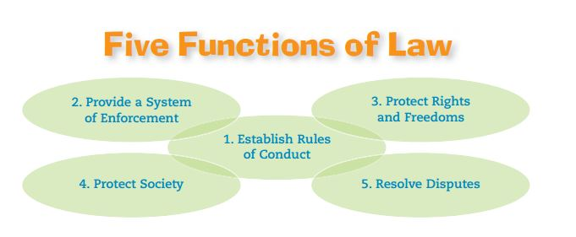
Notes:
1. Establish Roles of Conduct: outline guidelines to help reduce conflicts between people living together in society (ie. Law that you must pass a test to get your driver’s license – imagine if no rules for the roads…)
2. Provide System of Enforcement: laws must be enforced to have meaning – consequences for breaking laws through police & courts
3. Protect Rights and Freedoms: laws encourage values of tolerance and respect by protecting basic freedoms (freedom of peaceful assembly, freedom of expression)
4. Protect society: criminal laws protect people from harm, civil laws protect people from being harmed or taken advantage of (eg occupational safety laws to protect workers on the job)
5. Resolve Disputes: law helps settle conflicts – negotiation, court system – laws create order and ensure fair resolution of disagreements.

Slide 9
Gallery Walk Activity… What is the link between law, morality, and justice?

Slide 10
Briefly discuss…
In what way are law & morality connected?

Slide 11
law
...the regulation of life in society based on principles of reason and fairness

Slide 12
morality
...a system of values that outlines concepts of right and wrong, as well as good and bad behaviours

Slide 13
Law & Morality cont.
society’s laws reflect the morality of its citizens and indicate the moral ideas of a society
morality...and laws...change as society’s attitudes and moral standards change
because a society’s laws reflect moral ideas, controversial issues emerge

Slide 14
Law & Morals cont.
For example
Should it be against the law to help a loved one who is suffering to die with dignity?
Should capital punishment be legalized?
Should abortion be legal or not?
Should parents be allowed to spank their children?
Why does our society allow the sale of alcohol, tobacco and marijuana, but make other drugs illegal?

Slide 15
Law & Justice
what is ‘justice’?
justice defined by 4 key characteristics:
all cases treated alike - but treat different cases differently
laws shouldn’t discriminate based on irrelevant characteristics
laws shouldn’t be influenced by a person’s power or wealth
the law should conform to society’s values and beliefs

Slide 16
Community Standards
Laws apply to society as a whole but may go against the beliefs of one or more communities such as ethnic, religious or other groups who might have different beliefs.
This might apply to laws related to abortion, gay marriage, right to life and so on, where one or more groups in society might disagree with the law as it stands.

Slide 17
Law and Justice
Today we believe that law must ensure justice for all. This was not always the case as in the past it was considered normal that law applied to people differently depending on social status or wealth.
Inequality was not considered injustice, but today we would see it differently. We want to see the law applied equally regardless of wealth, race, religion, gender and so on.
Does this always happen?
Notes:
See John Rawles handout on Principles of Justice

